Slide 1
Digital Hotspots
Mark Ehr | K0EHR
285 Tech Connect Radio Club, October 7, 2023

Slide 2
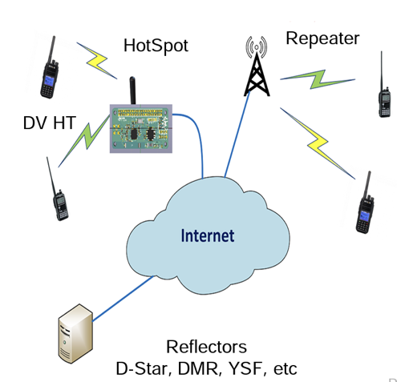
A quick intro to digital radio and hotspots
Digital-capable radios connect either via a hotspot or a digital repeater
Internet carries the digital signal to destination reflector or another digital radio
Digital radios can also communicate directly via simplex
Hotspots eliminate the requirement for a repeater and do not tie up repeater frequencies
PC USB dongles may also be used with hotspots

Slide 3
What is a hotspot and why should I care?
Hotspots allow digital radios to communicate without a repeater
Most hotspots support multiple digital protocols–though typically not more than one at a time
E.g. Yaesu System Fusion (YSF), DMR, D-Star, etc
Hotspots can also be used to bridge between protocols, eg YSF to DMR
Only the hotspot and an Internet connection are required
Hotspots can also bridge repeaters to other digital networks and modes (SkyHub Link is a great example)
Hotspots can be purchased off the shelf or built DIY-style using Raspberry Pi microcontrollers
Examples: OpenSpot, ZumSpot, Pi-Star

Slide 4
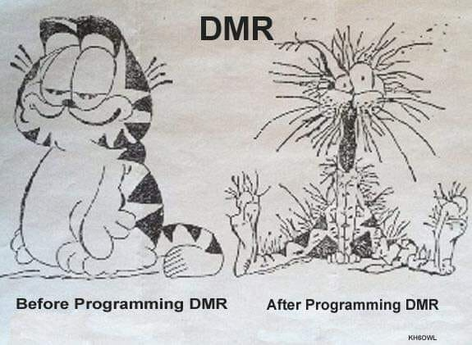
A quick overview of digital amateur radio protocols used by hotspots
Yaesu System Fusion aka YSF aka Wires-X aka C4FM
The easiest “point and shoot” digital protocol
ICOM D-Star
Difficult
Digital Mobile Radio (DMR)
Created by Motorola; modified for ham use
Most difficult
And many others (~20 total)
P.25, NXDN, AllStar, M17, Tetra, etc etc etc
Very difficult and not very common

Slide 5
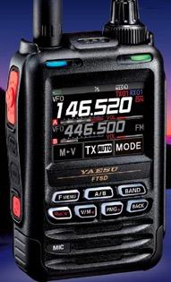
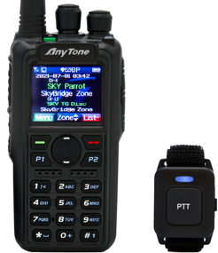
Recommended digital radios
DMR
Anytone AT-D878UVII Plus, AT-D578UV Plus (Bridgecom is a recommended retailer for DMR newbies)
Radioddity GD-77 with OpenGD77 firmware, GD-88
Kenwood, Motorola commercial DMR radios (most require reprogramming)
Others: Hytera, Retevis, TYT (I have no experience with them)
Baofeng/BTECH **NOT RECOMMENDED**
D-STAR
ICOM ID-50A, ID-52A, IC-705, IC-5100A, IC-7100
Kenwood TH-D74A/D75A
Yaesu System Fusion (YSF) aka Wires-X1
FT-70DR, FT1DR-FT5DR, FTM100DR-500DR

Slide 6
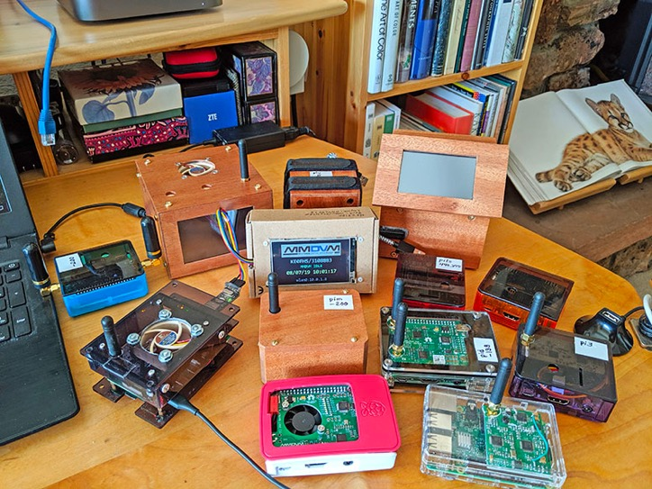
Choosing a hotspot
Easiest: off-the-shelf (also the most expensive)
OpenSpot ($229-$300) (supports on-board cross-mode)
ZumSpot ($100-$250) *some versions also require a RPi
Jumbospot, NanoSpot, Skybridge, etc etc
Cheapest: Pi-Star DIY
Uses a Raspberry Pi plus an MMDVM “hat”
Some are pre-assembled; others require assembly
Can be built for as little as $50
Raspberry Pi Zero-W $16 (or later models)
MMDVM “hat” + case $20-$50+
MicroSD card $10
Pi-Star open-source software $0
Requires computer skills (Linux/burning ISOs) and basic soldering
Notes:
Photo credit: Toshen KE0FHS

Slide 7
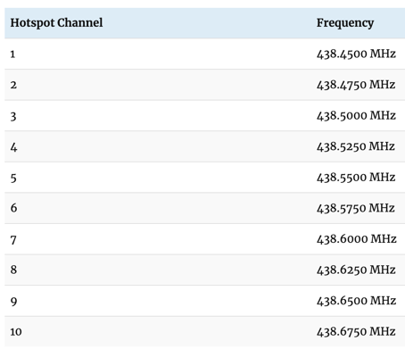
Simplex/Duplex hotspots and frequencies
Simplex hotspots transmit/receive on a single frequency
Duplex hotspots allow you to monitor two different channels / time slots simultaneously
Hotspot frequencies are governed by local band plans
CCARC guidelines: https://www.ccarc.net/wordpress/hot-spots/
Notes:
https://www.ccarc.net/wordpress/hot-spots/

Slide 8
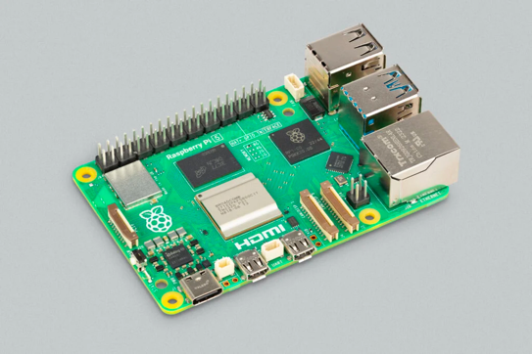
What is a Raspberry Pi (RPi)?
Raspberry Pi is a Single Board Computer (SBC) that includes a processor, on-board RAM, USB ports and video output at low cost ($15+)
RPi was the foundation for the ham radio hotspot revolution and remains a major component of most hotspots
RPIs are Linux-based; Raspbian is the official O/S but they can run others as well
Many flavors of Linux, plus Windows IoT and Android

Slide 9
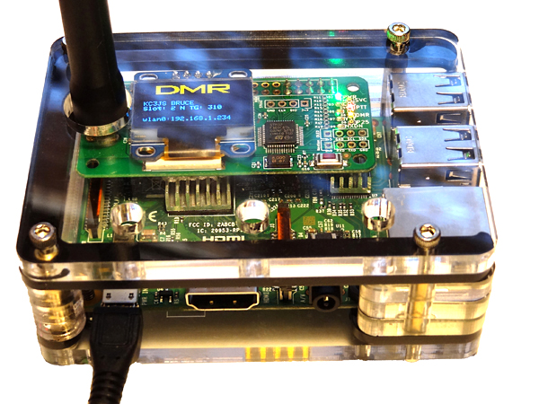
Pi-Star Demo

Slide 10
Additional resources
Colorado Digital Multiprotocol: https://coloradodigital.net/
DMR talkgroup 31088, D-Star Reflector XLX303, YSF 30300
SkyHub Weekly Digital Learning Net: Wednesdays @ 7pm on SkyHub Link + HD Happy Hour after the net (on talkgroup)
Pi-Star website (downloads/forums/etc): http://www.pistar.uk
Raspberry Pi website https://www.raspberrypi.com/products/
Retailers: Adafruit, Sparkfun, Micro Center, PiShop.us
Amateur Radio Notes (incredible site by Toshen KE0FHS with tons of info): https://amateurradionotes.com/index.htm

Slide 11
Thank You!
Mark Ehr | K0EHR
k0ehr@arrl.net

